Slide 1
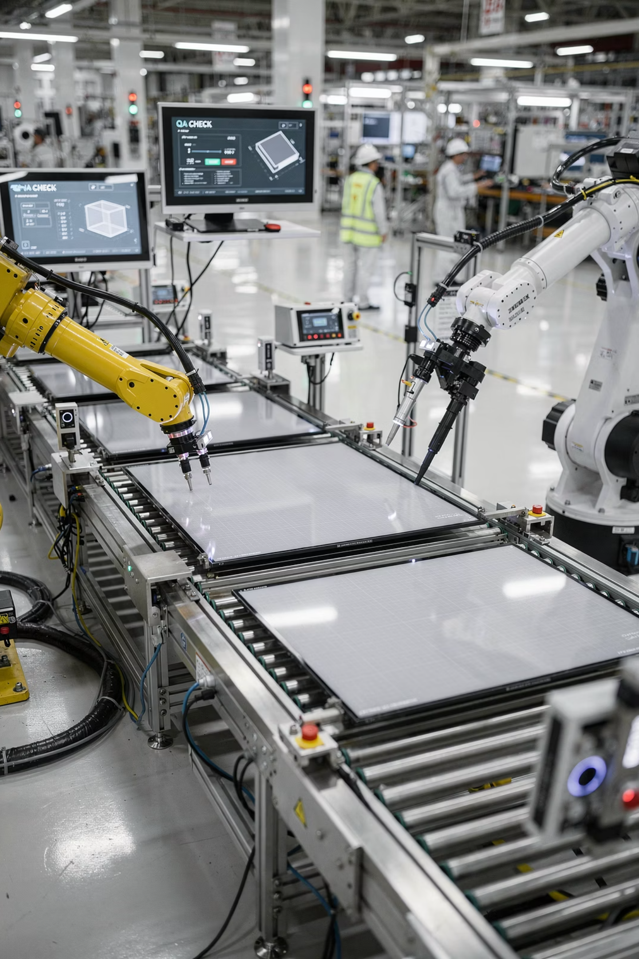

Automated TV Defect Detection Using Generative AI
Presented by: Amit Wagensberg, Ori zarfaty, Yaniv Hananis

Slide 2


Motivation & Use Case
Defect Detection in TV Manufacturing
Why This Problem Matters
Ensuring product quality on the assembly line.
Reduces return and repair costs.
Preventing faulty products from reaching customers.
Minimizes manual inspection expenses.
Enhances customer satisfaction.
Current methods include manual checks or classical algorithms, which are often inefficient or prone to human error.

Slide 3
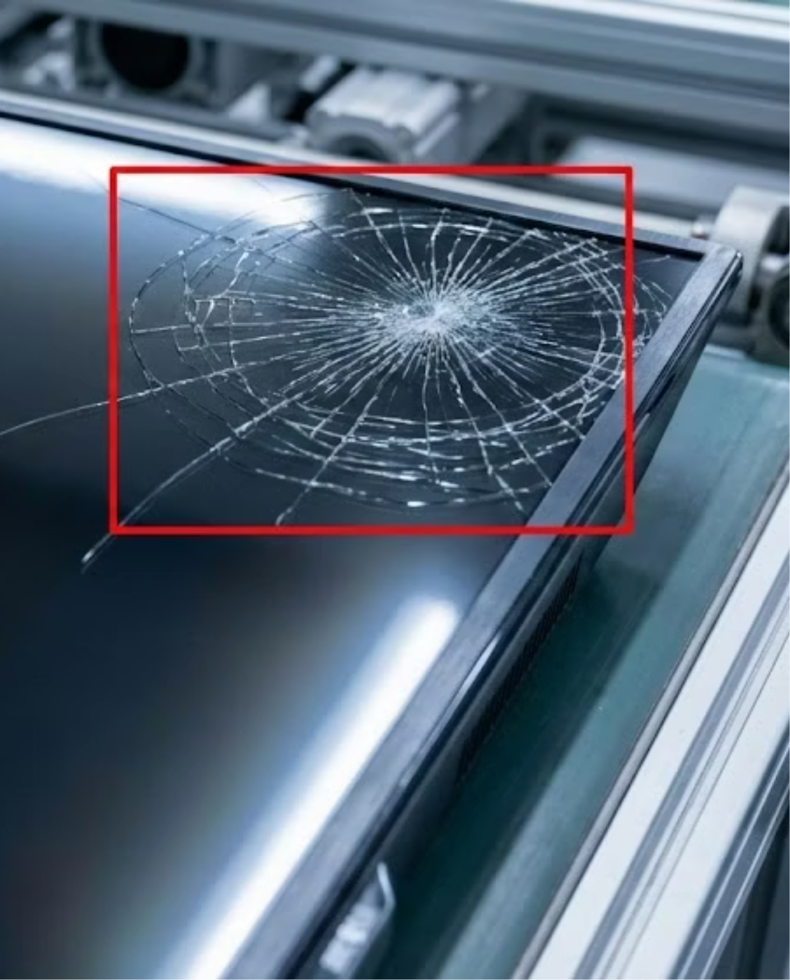
The Task: Automated Object Detection
Problem Statement:
Develop an automated system to detect and classify visual defects on TV screens.
Inputs:
Image of a TV screen from the production line.
Outputs:
Classification of defect type: Bezel Cracks, Corner Chips, Air Bubbles, etc.
Location of defect with a bounding box.

Slide 4
Synthetic Data Strategy: Leveraging Generative AI
1
2
Models & Techniques
Variations
Stable Diffusion with ControlNet and Inpainting to inject defects into images of flawless screens.
Camera angles and lighting conditions.
Various defect types (Bezel Cracks, Corner Chips, Air Bubbles), locations and light source.
Object Detection Model for defect identification.
Prompt Example
"Photorealistic spiderweb crack on black LCD TV screen, shattered glass texture, sharp jagged edges, realistic reflection, 4k resolution, industrial inspection photo style."

Slide 5


Evaluation Metrics: Ensuring Accuracy and Reliability
mAP (Mean Average Precision)
Recall
Measures accuracy in defect localization and classification.
Guarantees detection of all actual defects.
Prioritizes avoiding false negatives (missed defects) over false positives.
Ensures precise identification of defect type and position.

